Slide 1
Personalized Recommender for Implicit Data
Walmart Internship Report
Zehao Guan, 2019/08/01
Notes:
Hi, everyone. I'm Zach from personalization team. Today I'm going to talk about my intern project during this summer. Let's get started.

Slide 2
Introduction
Project
Future Work
Conclusion
Notes:
I will present in following aspects.

Slide 3
Introduction
Project
Future Work
Conclusion
Notes:
First, let me briefly introduce my project.

Slide 4
Abstract
Target
Design a personalized recommendation system for implicit feedback data.
Methods
Latent factor model based collaborative filtering, like pointwise/pairwise matrix factorization and factorization machine with libFM.
Experiment
Split into train/validation data in temporal manner;
Apply ranking based metrics for model evaluation.
Notes:
The target is to design a personalized recommender for implicit data. We implement latent factor model based collaborative filtering, including pointwise/pairwise non-negative matrix factorization and factorization machine methods. To evaluate the proposed model, we perform the experiment in following steps. On one hand, to capture sequential users’ purchase behavior, we split into the train/validation data in temporal manner. On the other hand, as items ranked higher should be more preferred by customers, ranking based metrics are applied. Our experiment on Walmart.com transaction data shows potential improvement on top-N recommendation performance.

Slide 5
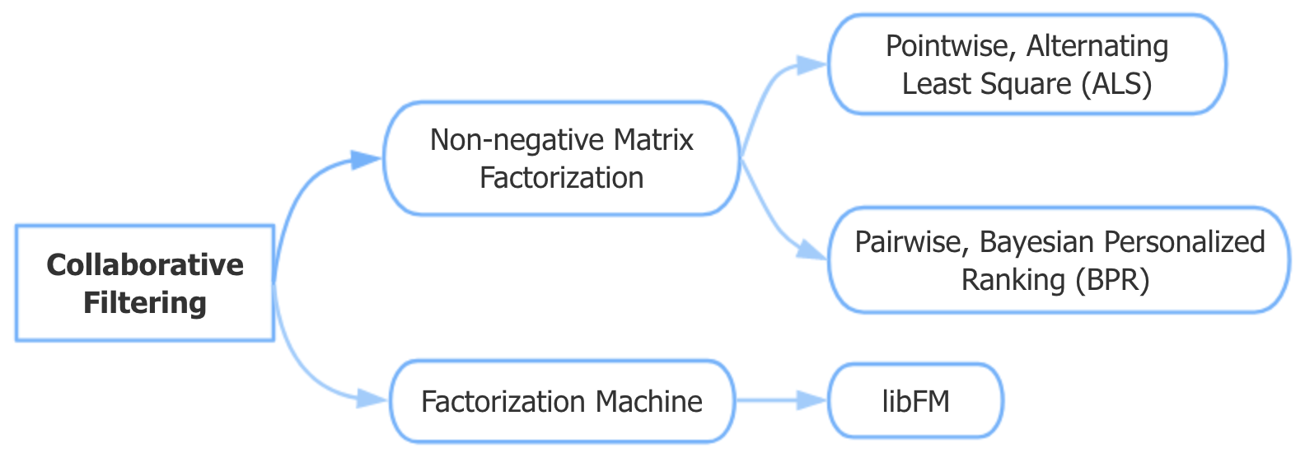
Sketch
Notes:
Here's the sketch for my project progress. Initially, I implement pointwise NMF based collaborative filtering demo with small-scale data, using alternating least square with regularization method. Afterwards, I attempt pairwise method with Bayesian personalized ranking. Finally, in face of the large-scale data, I use factorization machine to solve the scalability issue.

Slide 6
Introduction
Project
Future Work
Conclusion
Notes:
Then, I'll talk about my project progress.

Slide 7
Background
Unlike extensively researched explicit feedback, no direct input from the users regarding their preferences.
Treat transaction data as indication of positive and negative preference associated with varying confidence levels.
Should design a scalable optimization procedure and explainable factor model for recommendations.
The target is to realize top-N personalized recommendation based on users’ response.
Notes:
This is the first time I handle implicit feedback data, which has a big difference from explicit model I've learnt in school.
The object of the project is to...

Slide 8
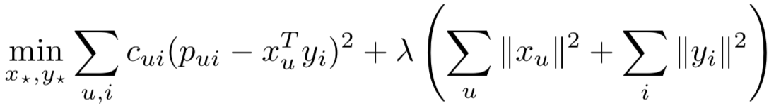
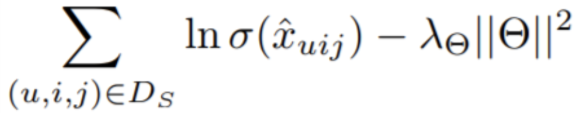
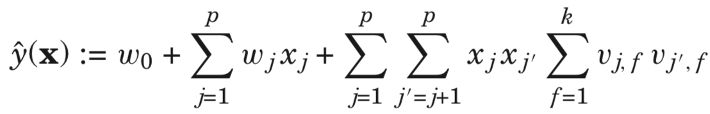
Algorithm
Pointwise NMF, Alternating Least Square (ALS)
Pairwise NMF, Bayesian Personalized Ranking (BPR)
Factorization Machines with libFM
Notes:
Here I list the formula I referred in some classic papers in this field, which are brought up about ten years ago. And nowadays they are widely used in the industry.
ALS starts by treating one set of latent factors as constant and update the other. Op timization would be performed based on the rank of these user/item pairs instead of scoring just on the user-item interaction. FMs combine the high-prediction accuracy of factorization models with the flexibility of feature engineering.

Slide 9
Experiment Design
Write models from scratch which is more flexible for metrics evaluation and prediction.
To capture sequential users’ purchase behavior, split into train/validation data in temporal manner.
As items ranked higher should be more preferred by users, ranking based metrics are applied.
Start with demos on small-scale data, and then improve the scalability.
Notes:
For the implementation of the mentioned algorithms, I tried to use functions from the PySpark library, consider its distributed computation ability. But I met the difficulty about the data format conversion when I did the metrics evaluation. So I write the model from scratch and it's more flexible for evaluation and prediction. Also, test proves the time efficiency has no big difference.
To conduct the experiment in a scientific way, we design the procedures in following steps.

Slide 10
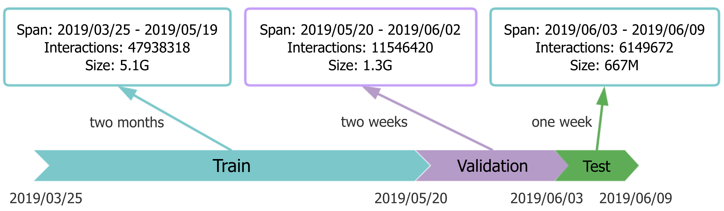
Temporal Manner
Notes:
As I mentioned, I split the data in temporal manner. This is the time axis, and we use two months data for training, two weeks data for validation, and the following one week for testing. And the users to recommend items for are selected from the training set.

Slide 11
Ranking Metrics
Hit ratio (HR)
Normalized discounted cumulative gain (NDCG)
Mean average precision (MAP)
Area under curve (AUC)
Top-N recommendation !
Notes:
Here lists the ranking metrics I applied in the experiment, which are very popular in top-N recommendation research.

Slide 12
Data
Database: ucid
Table: common_transaction_model
Source: Walmart.com
Columns: cid, catalog_item_id, purchase_date
Features:
Implicit feedback
High sparsity
Imbalance
Notes:
The data I used comes from Walmart.com transaction table. This set of queried data has features like...

Slide 13
Preprocess
Clean outliers like infrequent customers/items and resellers.
Map user and item ids to categorical values.
Store observed data in <userId, itemId, rating> triple format.
Convert to sparse matrix for other operations.
Sample data in demo:
Ignore: 14847105 * 2958922
Raw: 14929995 * 3008950
Processed: 34209 * 47857
density: 0.0712%
Notes:
I preprocess the raw data following these steps. For the rating, I try two methods, one is to set the value to 1 regardless of the purchase times for each users. The other is to normalize the frequency and take the user bias distribution into consideration.
Let's take the sample data in my first demo as example. The distribution is like this.

Slide 14
Train
< 15
Assume n_iters that is enough for the loss to converge.
Notes:
Let’s take the first demo for instance, use pointwise NMF for matrix factorization.
First, I use threshold to find reasonable range of number of iterations, that the training loss arrives at convergence. The RMSE and loss curve with the increasing of iterations is plotted here. After this step, I could confirm what range of iterations I can set to train the model.

Slide 15
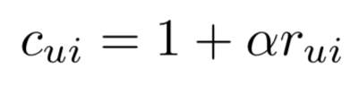

Evaluation
0.01
5
Tune on parameters like _lambda and alpha.
Notes:
Then, I begin to tune on the important parameters like regularization parameter and alpha, which measures for the confidence level.

Slide 16
Evaluation
Extend scale to 0~400, and select best n_factors for test, also consider computation cost and avoid over-fitting.
Notes:
Last, I will tune on the parameter, number of latent factors.

Slide 17
Evaluation – Model selection
Top-k
0/1 v.s. normalized frequency
Notes:
After I figure out the set of hyperparameters to select the best model, I test the ranking metrics tendency with the increasing of top-k.
Besides, I repeat the previous procedures and make comparison. I found that using normalized frequency data outperforms in the NDCG/MAP, and close in HR. In a sense, I believe the purchase frequency can indicate the user' preference level.

Slide 18
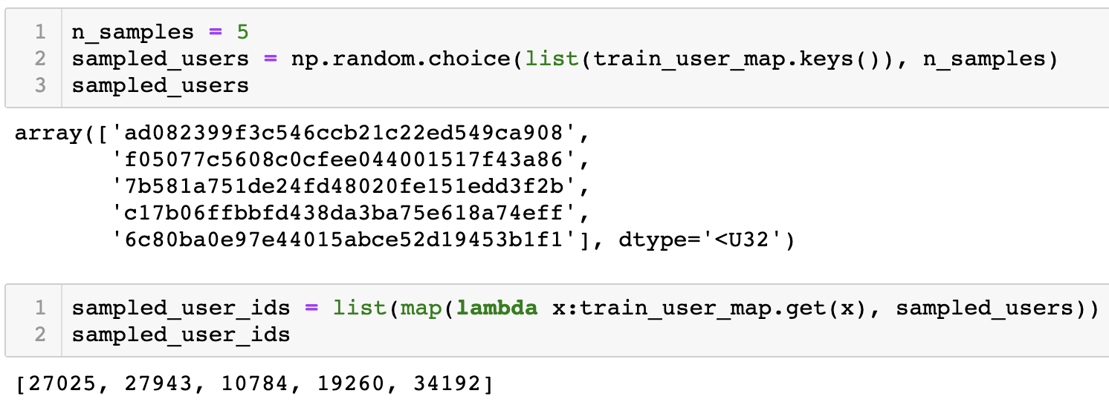
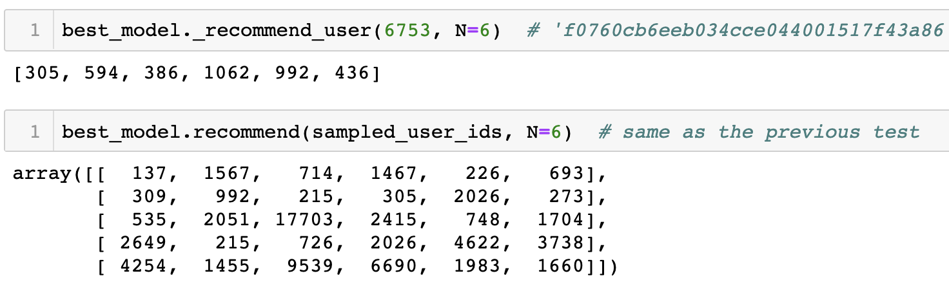
Test – Recommend for users
cid
user_id
item_id
https://gecgithub01.walmart.com/z0g00mx/Intern_project/blob/master/als.ipynb
Notes:
After validation, I test the system on sampled users and items.

Slide 19
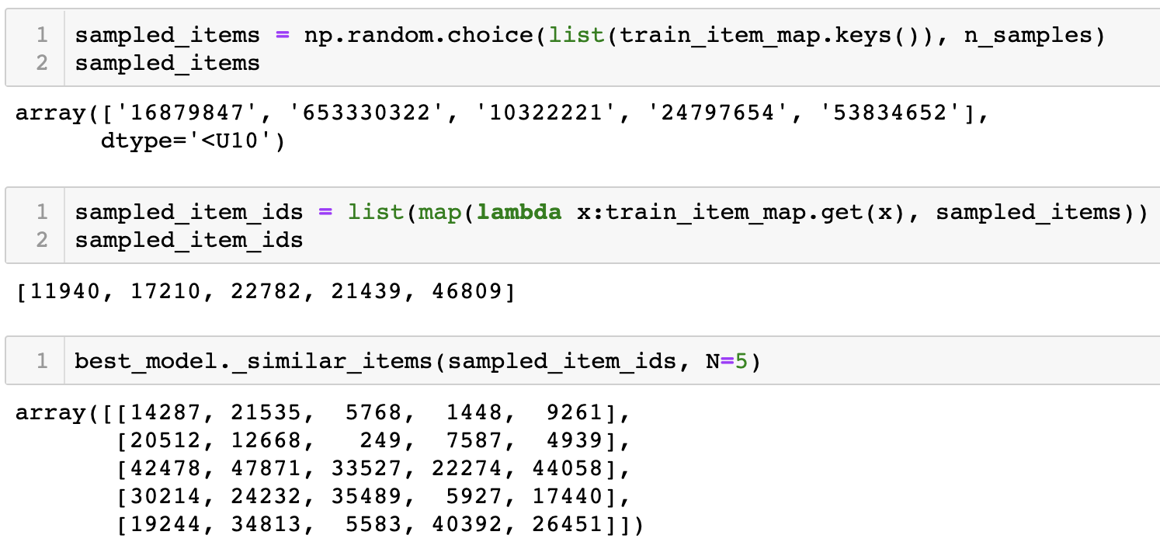
Test – Find similar items
catalog_item_id
item_id
https://gecgithub01.walmart.com/z0g00mx/Intern_project/blob/master/als.ipynb
Notes:
Same for the sampled items.

Slide 20
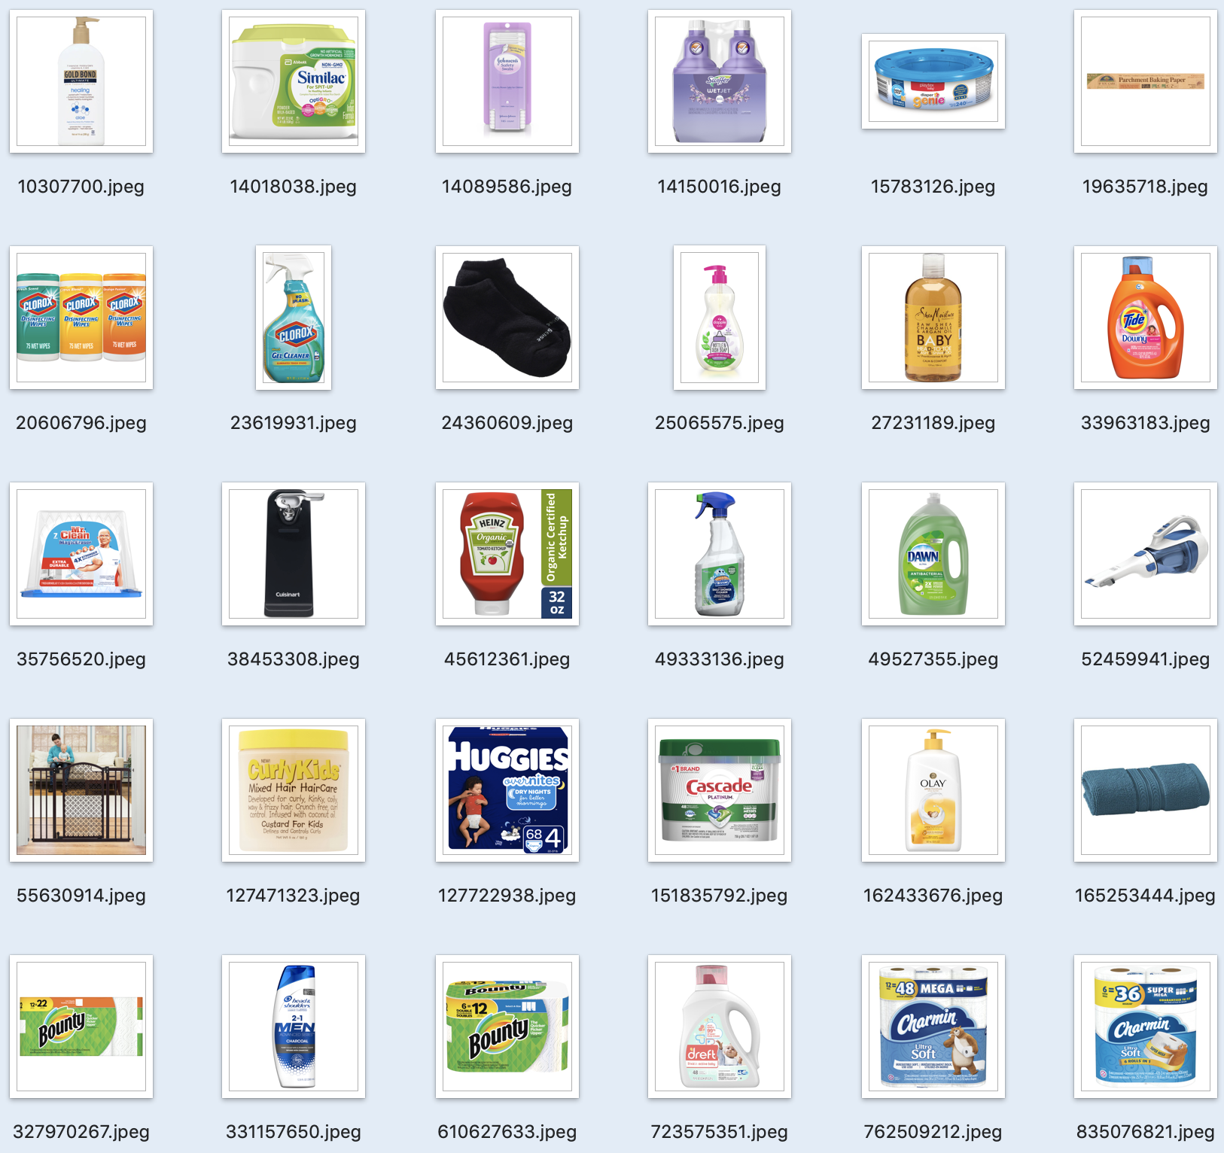
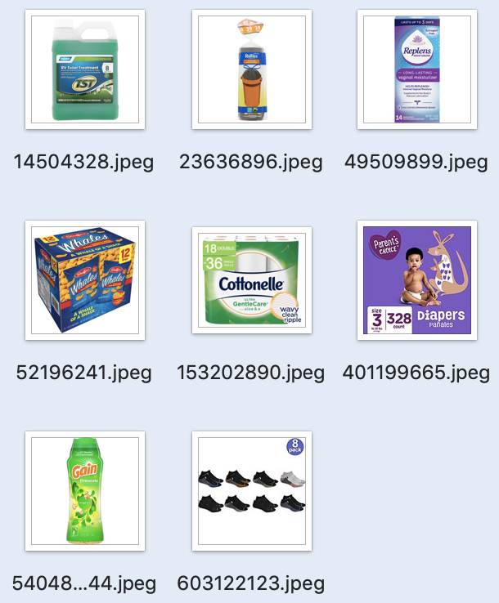
Test – Case study
Recommend
Top-8 recommended items
User purchase history
Notes:
Here I select one sample customer and visualize the items as below.

Slide 21
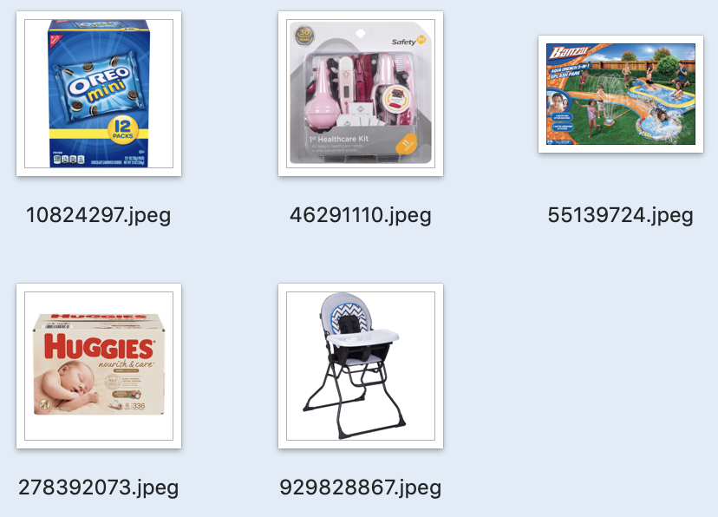
Test – Case study
Similar
Sampled item
Top-5 similar items
(KNN, Euclidean metric)

Slide 22
Analysis
Separability of latent factors with t-SNE, K-means
Pointwise method performs better than BPR
Notes:
After the experiment, I do some analysis on the results.

Slide 23
Accomplishment
Three recommender demos in same experimental procedures with Walmart.com transaction data.
Code implementation for large-scale data.
(1856520 * 831859)
Write bash scripts to use libFM by C++ for matrix factorization to get latent factors.
Python codes for preprocessing, ranking metrics evaluation and personalized recommendation.
https://gecgithub01.walmart.com/z0g00mx/Intern_project/tree/master/CF_libFM
Notes:
What I've done in the project is listed below.

Slide 24
Introduction
Project
Future Work
Conclusion
Notes:
For future work of this project,

Slide 25
Future Work
Realize industrial level APIs of the recommender demos.
Evaluate the model with different sources of data.
Besides these baseline models, explore more advanced methods for matrix factorization and optimization.

Slide 26
Introduction
Project
Future Work
Conclusion

Slide 27
Challenge
Inexperience with recommendation system for implicit feedback dataset.
Lots of efforts to process highly sparse and unbalanced transaction data.
Difficulty to apply PySpark for evaluating ranking metrics.
Problems in face of scalability.
Notes:
During the work, I meet several challenges.

Slide 28
What I’ve learnt
Tools like Hive, Spark, Kubernetes, libFM…
More familiar with libraries like pandas, scipy, sklearn…
Knowledge about the field of implicit recommendation, like classic models and widely-used ranking methods.
Experience with experiments design and conduct.
Capability to learn by doing.
Notes:
Finally, I should talk about the harvest.
And here, I want to say thanks for my manager, my mentor and other PhD interns. Without their guidance and the discussion with them, I cannot overcome all the difficulties by myself.

Slide 29
Reference
Hu, Yifan, Yehuda Koren, and Chris Volinsky. "Collaborative filtering for implicit feedback datasets." 2008 Eighth IEEE International Conference on Data Mining. Ieee, 2008.
Koren, Yehuda, Robert Bell, and Chris Volinsky. "Matrix factorization techniques for recommender systems." Computer8 (2009): 30-37.
Rendle, Steffen, et al. "BPR: Bayesian personalized ranking from implicit feedback." Proceedings of the twenty-fifth conference on uncertainty in artificial intelligence. AUAI Press, 2009.
Rendle, Steffen. "Factorization machines with libfm." ACM Transactions on Intelligent Systems and Technology (TIST)3.3 (2012): 57.

Slide 30
Appendix
GitHub link:
https://gecgithub01.walmart.com/z0g00mx/Intern_project
Notes:
Attached is the project repo link on the GitHub, including all the implementation details. Feel free to contact me, if you would like to discuss something about my project.

Slide 31
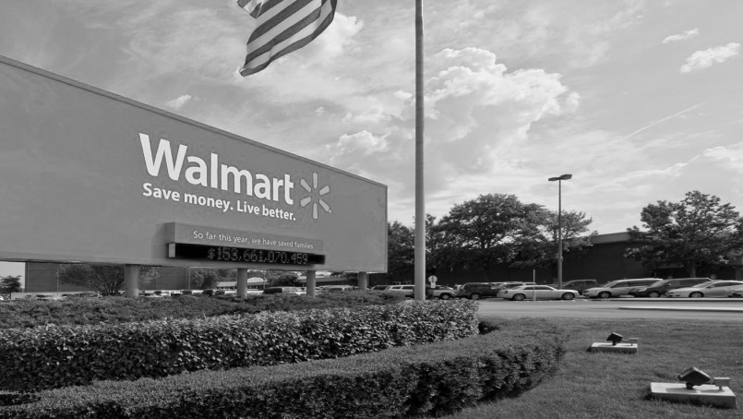
Thank You!
Notes:
Thanks.

